Slide 1
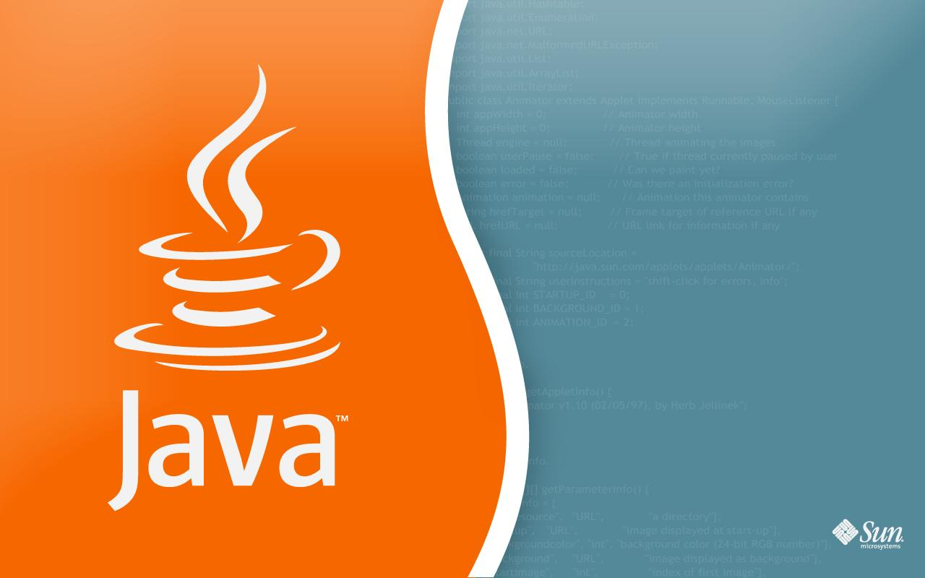
CS-0401
INTERMEDIATE PROGRAMMING USING JAVA
Prof. Dr. Paulo Brasko Ferreira
Spring 2018

Slide 2
Chapter 1: Introduction to Computers and Java

Slide 3
Chapter Outline
Computer Systems
Programming Languages
Why using Java
Bite code and Java Virtual Machine
Compiling and Running a Java Program
Development Environment
Text Editors versus IDEs

Slide 4
Computer Systems
Computer Systems can be subdivided into two categories:
Hardware
Software

Slide 5
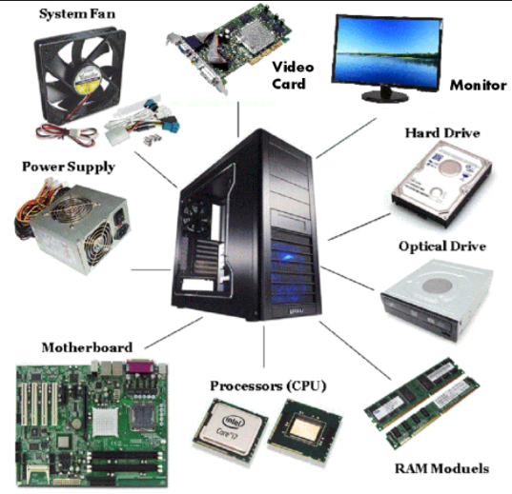
Hardware

Slide 6
Software
Software:
A set of instructions that enables the computer to perform a task
Calculates the income tax
Simulates a space probe trajectory
Software can also be referred as a Program
They run on a computer
But what do we mean by “computer” nowadays?

Slide 7
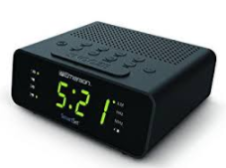
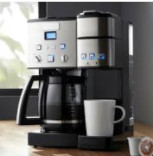
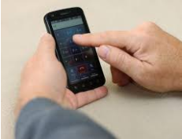
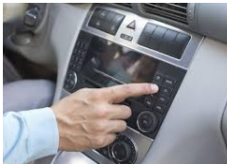
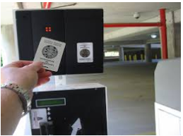
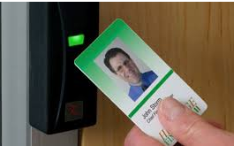
Hardware and platforms
An ordinary day in Annita’s life…

Slide 8
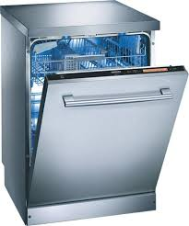
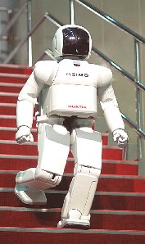
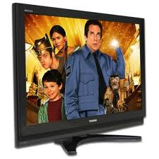
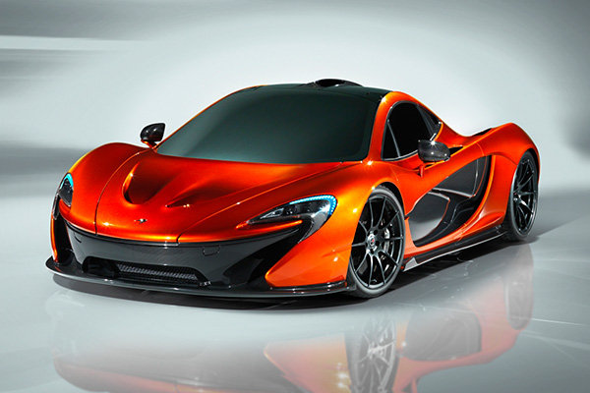
What platforms can we program?

Slide 9
What abilities should an useful program have?

Slide 10
Store data via Identifiers and Variables
Get data in
Your program
Control Structures
Get data out
Statements and
Expressions

Slide 11
Programming Languages
Program is a set of instructions
Different types of programming languages out there:
Basic | Pascal | C | C++
Fortran | Perl | PHP | Python
Cobol | C# | JavaScript | Ruby
Java | Visual Basic
No language is best for every single application

Slide 12
Why are we using Java instead of C++ to create our programs in this course?

Slide 13
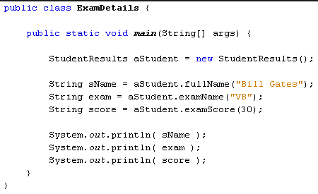
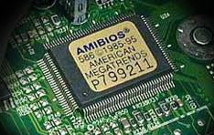
Basic programming steps
?
?
?

Slide 14
Interpreter / compiler
Good morning!
(Happy because she finally understands what he is saying!)
Compiler

Slide 15
A small problem in this picture…
- What happens if you are in a meeting with many people from different countries?
- You would need an interpreter for each spoken language!!!

Slide 16
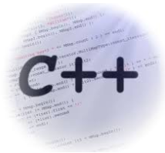
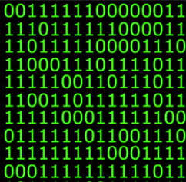
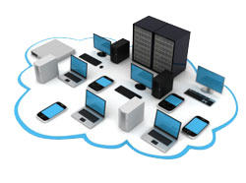
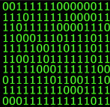
Why is this a problem?
Mac
Linux
Windows

Slide 17
Java Features

Slide 18
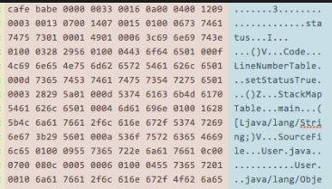
Java is an Interpreted Language
Compiler (javac)
Byte Code (.class)
The “interpreter”.
It comes with Java Installation. It’s called when you run your program with “java”.
Source Code (.java)

Slide 19
Platform Independent
Your Responsibility
User Responsibility
Windows
Mac
Linux
Solaris

Slide 20
Notes on Interpreting Code
Interpreter code executes more slowly than regular compiled code
C, C++
Great for distribution over multiple platforms
For faster Java run-times, one can use JIT compilation of the bytecode

Slide 21
Writing your Java Program

Slide 22
Before writing our first Java program, let’s ask ourselves:
“Which editor should we use to write our Java code?”

Slide 23
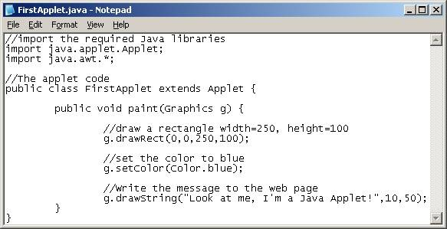
You could use notepad-like editors

Slide 24
But we really should be using an IDE!

Slide 25
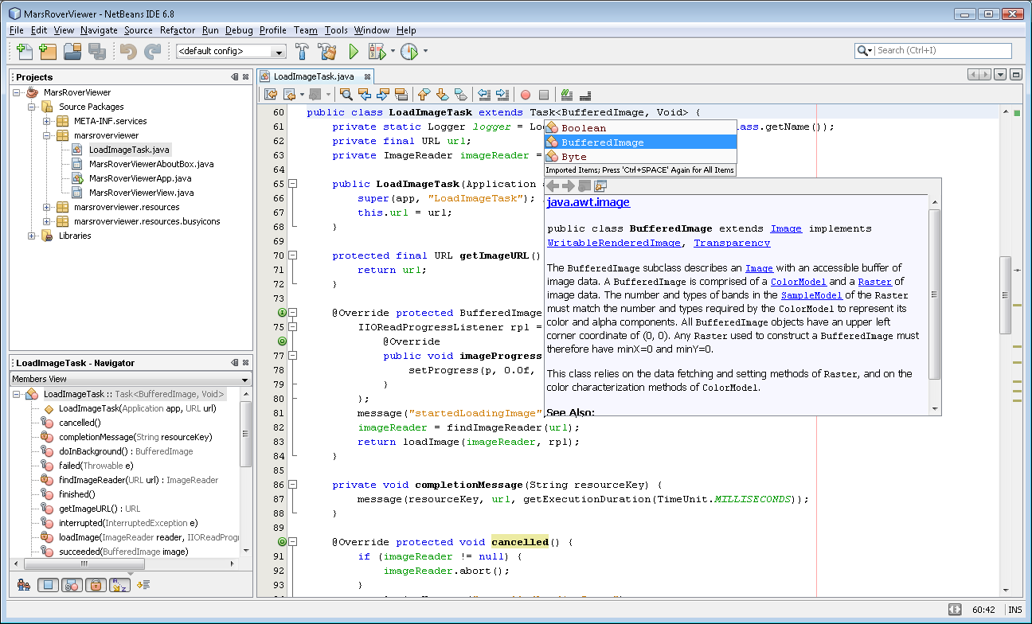

Slide 26
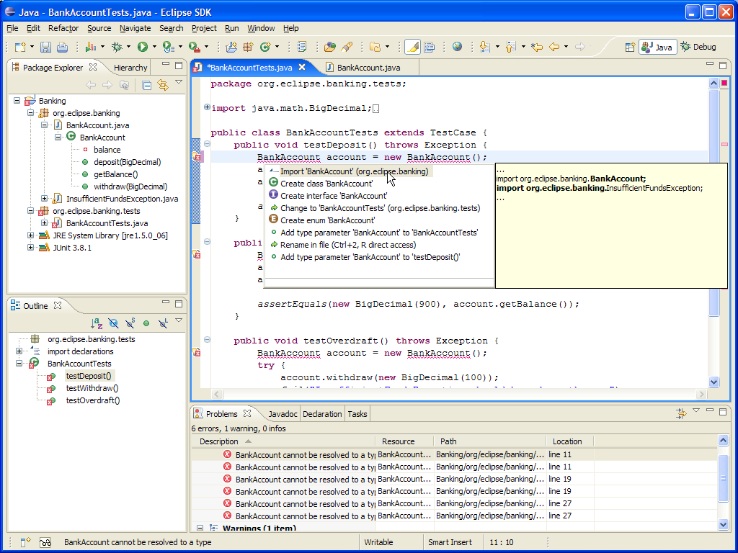

Slide 27
NetBeans Installation Instructions
Search for “Netbeans download”
Download JDK with Netbeans IDE bundle
Video #01: How to Install Netbeans and Java in your Computer

Slide 28
Compiling and Running your Java Program

Slide 29
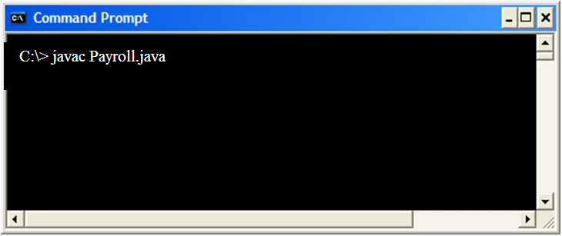
Manually Compiling a Java code
Compiling the java code: javac Filename
Example:
Payroll.java will be “translated to” Payroll.class (bytecode)
Payroll.class will be the one to be interpreted by the JVM

Slide 30
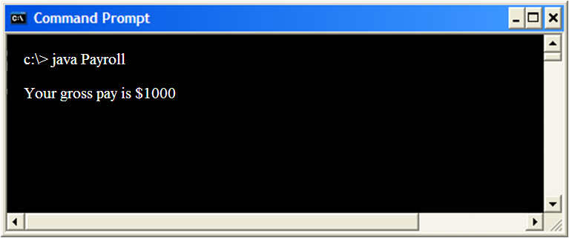
Running the java class
Running the java code: java Filename
Example:

Slide 31
Video Library
For more information on compiling and running your codes
Course website >> Video Library >> Videos on How to Compile … >>
Video #03: Compiling and Running Java in a Terminal Window

Slide 32
Compiling and Running Our First Java Code

Slide 33
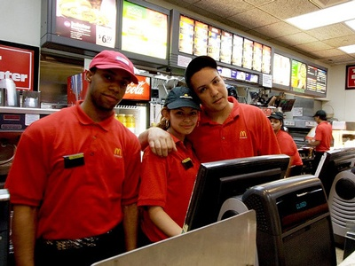
Computing how much you will earn in a week of work
$25 per hour
40 hours a week
How to compute the weekly income in this specific case?

Slide 34
Our First Java Code
public class Payroll {
public static void main(String[] args) {
int hours = 40;
double grossPay, payRate = 25.0;
grossPay = hours * payRate;
System.out.println(“Your gross pay is $” + grossPay);
}
}
See Payroll.java

Slide 35
Our First Java Code
Remember, we need to compile our code to run it!

Slide 36
Manually Compiling a Java code
Compiling the java code: javac Filename
Example:
Payroll.java will be “translated to” Payroll.class (bytecode)
Payroll.class will be the one to be sent to the JVM

Slide 37
Running the java class
Running the java code: java Filename
Example: java Payroll

Slide 38
Using IDEs to develop, compile, debug, and running your Java code

Slide 39
Exploring NetBeans
Creating the same java program in the IDE
Explaining the source code that it generates for you
Placing a print command
Placing two variables
Understanding how the IDE helps you to find errors
Debugging your code
Executing the code

Slide 40
The Java Language

Slide 41
The Java Reserved Words

Slide 42
The Java Reserved Words
abstract | continue | for | new | switch
assert | default | goto | package | synchronized
boolean | do | if | private | this
break | double | implements | protected | throw
byte | else | import | public | throws
case | enum | instanceof | return | transient
catch | extends | int | short | try
char | final | interface | static | void
class | finally | long | strictfp** | volatile
const* | float | native | super | while

Slide 44
Any Questions?

